Slide 1

Module 3.
Options for manure management in intensive small-scale dairy systems
Improving manure management

Slide 2
Learning objectives of Module 3
Understand meaning of integrated manure management and its criteria
Know which options for integrated manure management are feasible for small-scale intensive dairy systems

Slide 3
Integrated manure management

Slide 4
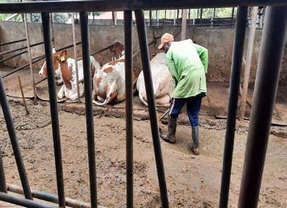
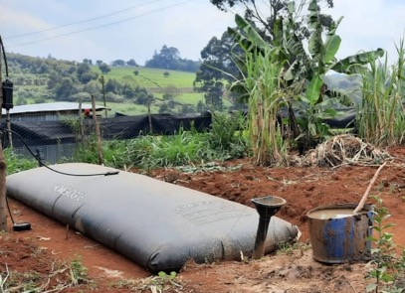
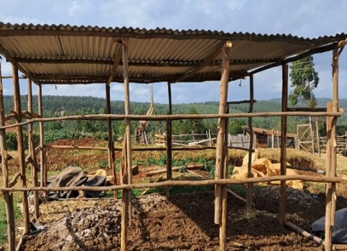
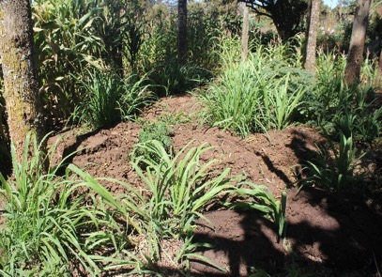
Integrated manure management for small-scale intensive dairy systems
Manure management is management of the whole manure “chain”:
integrated manure management
Options for improving manure management should:
  take into account collection, storage, eventual treatment and application and/or use of the manure
  focus on reducing loss of nutrients and negative environmental effects
  consider the feasibility and economy of the options.
Collection
Treatment
Storage
Application
Notes:
Improved management practices reduce nutrient losses, improving manure agronomic and economic benefits, and result in other co-benefits such as reduction of nutrient losses into the environment.

Slide 5
Options for integrated manure management

Slide 6
Options for improved manure management
Collection
Storage
Key points for improvement of collection and storage:
Type of barn: tied barn, loose housing system, deep litter system
Type of floor: earthen floor, sandy or concrete floor of walking area
Roofing of the barn/shed: partial roofing or complete roof
Frequency of manure removal, collection
Notes:
If liquids (urine) can be collected separately from solids (faeces), ammonia emissions can be lowered from the barn.
Concrete floors can lower losses by drainage/leaching of urine and part of the faeces, volatilization of ammonia and run-off by rain water.
A concrete floor with a roof in a zero-grazing unit and a quick, separate collection of urine and/or faeces in addition to storage in a closed concrete walled manure pit reduces NPK loss.
For the reduction of volatilization of nitrogen, leaching and run-off of nutrients and for the prevention or reduction of the risk of harmful pathogen buildup

Slide 7
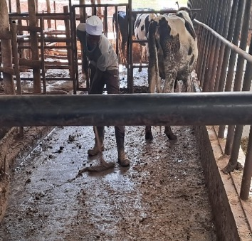
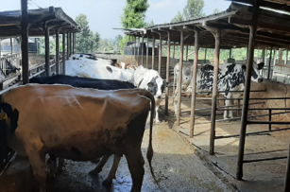
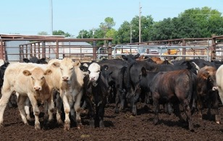
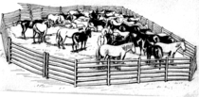
Options for improved collection
Areas of manure production
Areas of improvements
Improvements
Practices of improvements
Floor
Solid floors
Increasing the slope of the
walking floor
Using gutters to drain the urine
Barn
Roof
Roofing the confinements, including the walking area
Regular manure collection
Separation of manure liquid and solid fractions
Feedlot
Improved collection practice should:
Ease manure collection
Reduce losses via spills, leaching/drainage
Confinement

Slide 8
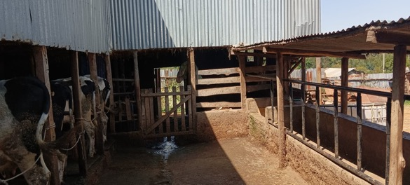
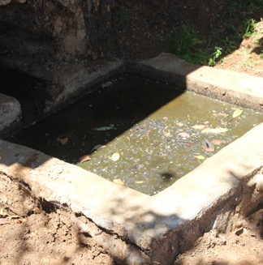
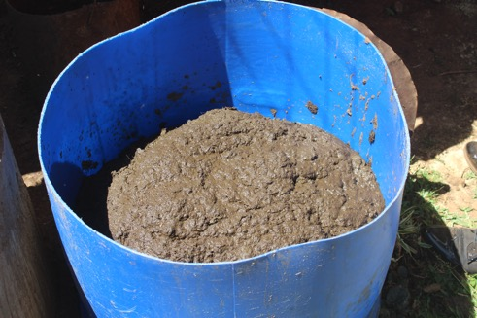
Separate collection of liquids and solids
Reduces loss of nutrients
(less ammonia volatilization)
Requirements: Investments in separate storages and extra labour (collection)
Methods:
Separate collection at time of excretion
Draining of liquids on sloping floor to a liquid storage
Partial separate collection of liquids and solids in barn:
Collection of solids from the floor
Notes:
Separation of urine and dung is potentially the most efficient in terms of maintaining the original ‘fertilization value’ of the manure
Loss of nitrogen due to volatilization is reduced (no/less mixing of dung with urine and no deposition on floor)
Good quality of liquid and solid fraction collected is easier to handle or more suitable for composting
Main questions for this option are its feasibility (to which extent does the system of separation work), and profitability of the system considering the investments needed
Partial separation of liquids and solids of the slurry
Through the adjustments of the walking area by modifying the floor of the zero-grazing unit to drain the urine quickly into a closed storage
A screen should be fixed for the separation of dung and urine, so the liquid can drain to the liquid storage and the remaining solids can be stored in a separate roofed storage
The solid fraction is easier to handle and could be composted or applied on lands
The liquid fraction could also be applied on forage land but the challenge is the transportation
Extra investments are needed for roofing and storage

Slide 9
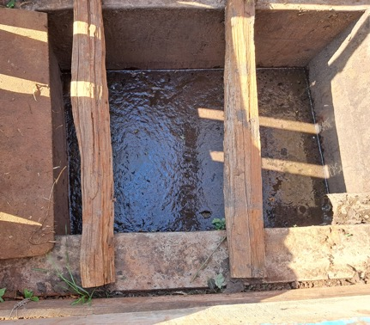
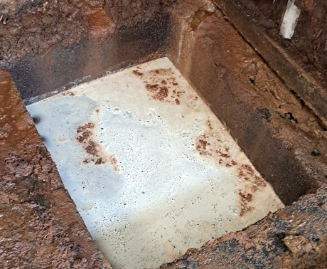
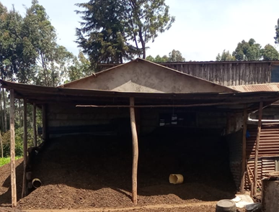
Options for improved storage (1)
Good storage of manure will reduce nutrient losses and reduce bad smell
Options for effective storage of slurries and liquids:
Closed, concrete walled pits or tanks
Slurry concrete pit
Urine concrete pit
Manure solids storage
Notes:
Storage of manure is an important component of manure management as it facilitates appropriate timing for manure application
Manure storages can be a significant source of odour and gaseous emissions. Fresh manure storages tend to give off odour and gas emissions when the surface is disturbed, such as windy conditions or during mixing
Covers have been demonstrated to provide effective odour and air emission control from manure storages by creating a barrier between the stored manure and wastewater and the airflow above
Use of covers improves the quality of manure by reducing the nutrient losses as it facilitates appropriate timing for manure application
Types of covers
Impermeable such as plastic covers
Provide a complete seal of the covered manure surface, i.e., do not allow the transfer of liquids or gases through them
Prevent rainwater from collecting on the surface
Provide excellent odour and emission control, but have a high capital cost

Slide 10
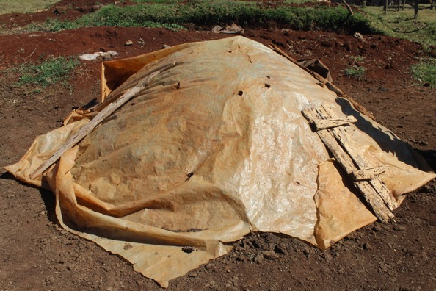
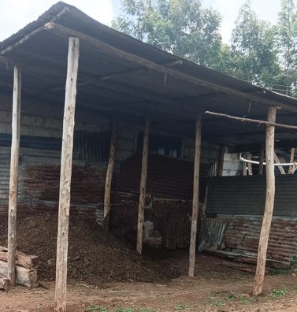
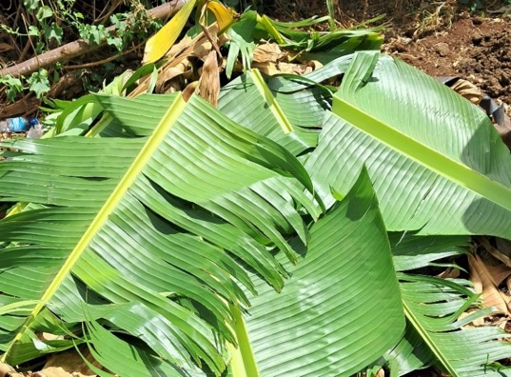
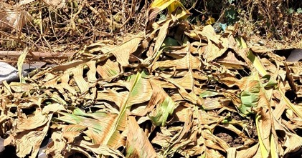
Options for improved storage (2)
Storage
Use of protective covers on manure heaps and piles will reduce nutrient losses
Options for protective covers on heaps and piles:
  (Semi)-permanent covers: plastic covers (cheap)
  Permanent cover: roofed shed (relatively high investment)
  Temporary covers: banana leaves, straw (short lived)
Semi-permanent
Permanent
Temporary
Notes:
Storage of manure is an important component of manure management as it facilitates appropriate timing for manure application
Manure storages can be a significant source of odour and gaseous emissions. Fresh manure storages tend to give off odour and gas emissions when the surface is disturbed, such as windy conditions or during mixing
Covers have been demonstrated to provide effective odour and air emission control from manure storages by creating a barrier between the stored manure and wastewater and the airflow above
Use of covers improves the quality of manure by reducing the nutrient losses as it facilitates appropriate timing for manure application
Types of covers
Impermeable such as plastic covers
Provide a complete seal of the covered manure surface, i.e., do not allow the transfer of liquids or gases through them
Prevent rainwater from collecting on the surface
Provide excellent odour and emission control, but have a high capital cost

Slide 11
Options for improved manure management
Collection
Treatment
Reasons for treatment of manure :
  Production of a valuable product, e.g. biogas or compost
  Improvement handling (reduction of volume, moisture)
  Reduction of nutrient losses
  Reduction of risk human infections (e.g. killing of pathogens) and/or weed seeds
Options:
Biodigestion, drying (dehydration), physical separation, composting and refining

Slide 12
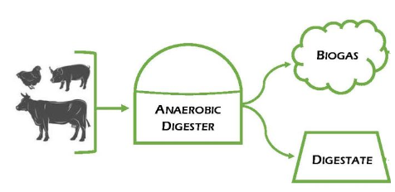
Options for manure treatment (1): biodigestion
Anaerobic digestion process in biodigester: breaking down of manure (organic matter)
Production of energy: biogas (methane) and digestate (bioslurry)
Bioslurry: organic fertilizer has low dry matter content, less organic matter and higher mineral N content than original manure
Notes:
Involves breaking down of manure (organic matter) under anaerobic conditions into biogas (source of energy) and nutrient-rich digestate (bioslurry) - fertilizer
It does not change the nutrient content of manure; bioslurry is still a valuable fertilizer
Biodigestion reduces greenhouse gas emissions (environmental impact), improves nutrient management and produces renewable energy

Slide 13
Options for manure treatment (2): air drying (dehydration)
Air drying:
  Evaporation of moisture to improve volume and handling
  Most applicable for moist manures: slurry and bioslurry
Advantages:
  End product is easy to handle and transport
  Reduction of odour
Disadvantages:
  Risk of drainage of nutrients during drying
  Losses of mineral N (volatilization)
  Difficult during rainy season

Slide 14
Options for treatment (3): mechanical separation
Collection
Mechanical separation
Mechanical treatment of slurries with manure separator into a liquid and a solid fraction
The solid fraction: a stackable organic fertilizer, easy to store and to transport (e.g. for sale)
Liquid fraction: fertilizer for crops and in fish farming
Liquid fraction contains more N and solid fraction more P
Disadvantage: relative high investment (separator)
Suitable for larger farms with surplus of manure
Treatment

Slide 15
Options for manure treatment (4): composting
Aerobic composting:
Natural process of decomposition by microorganisms:
  suitable reduction of volume and moisture
  Suits all farm situations (large, small) and all types of manure
End product:
  stable (moisture content, nutrients), easy to handle
  free of pathogens and viable weeds (aerobic composting)
Requirements: Availability and addition of other organic materials (green, dry)
Disadvantages:
  Labour intensive
  Nutrient losses (C,N) can be high
Collection
Notes:
Composting methods:
Heap or pile method, suitable for large-scale processing and for small-scale operations in areas with higher rainfall
Pit method, suitable for small-scale processing in areas with low rainfall and a long dry season and for composting of liquid manures
*It reduces manure volume, stabilizes the nutrients, eliminates odour, kills harmful pathogens and weeds, and produces a valuable product

Slide 16
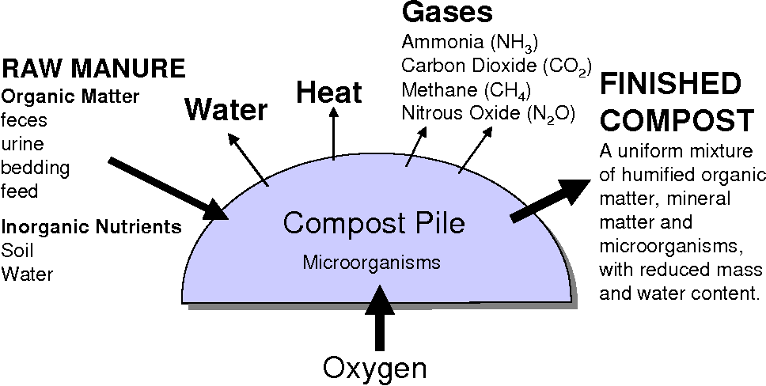
Composting process

Slide 17
Options for improved manure management
Treatment
Collection
Application
If possible, take sample of manure for lab analysis to determine nutrient content
Apply manure based on nutrient content and according to crop needs to avoid overfertilization
If separate collection of liquids and solids, allocation could be the following:
  Regular application of liquids (during weeding) on forage crops
  Application of solids on land (during cultivation) for food crops/cash crops
Incorporation of manure-slurry into the soil (mixing) at or directly after application:
  Reduction volatilization of ammonia (N)
  Better utilization of nutrients by the crop
Distribute manure evenly over the land or crop
Notes:
Surface application results in emission of ammonia and leads to a lower utilization of the mineral N
Liquid manure (containing much mineral nitrogen):
Good method: incorporates directly after application into the soil to prevent volatilization of ammonia N (avoid direct contact with seeds/plants):
For example by means of making furrows along rows of Napier grass and covering them with soil
Incorporate into the soil by spreading and direct digging into the land (for example when preparing for planting)
Solid/ dried manure
Spread and incorporate into the soil when digging the land
2 to 8 weeks before planting
Methods: in holes or spread and incorporated

Slide 18
Options for improved manure management: Summary
Options | Nutrient losses | Fertilizer value | Extra labour | Invest-ment | Effect on environment | Expected profitability
Baseline: uncovered heap, no roofing walking area barn | - - - | - - - | 0 | 0 | - - - | +-
Heap covered with plastic sheet | - - | - - | + | + | - - | ++
Roofing and closed storage | ++ | ++ | + | ++ | ++ | +
Direct separation liquid solids, closed storage | +++ | +++ | +++ | ++ | +++ | +- ?
Partial separation liquid solids, closed storage | ++ | ++ | ++ | ++ | ++ | +- ?

Slide 19
Options for improved manure management: Summary
Options | Nutrient losses | Fertilizer value | Labour | Invest-ment | Effect on the environment | Expected profitability
Mechanized separation Slurry | ++ | ++ | + | +++ | ++ | ?
Composting slurry/manure | +- | + | +++ | ++ | + | ?
Drying dung/ solid fraction | +- | + | ++ | + | + | +
Vermi culture | ? | + | ++ | ++ | ++ | ?

