Slide 1
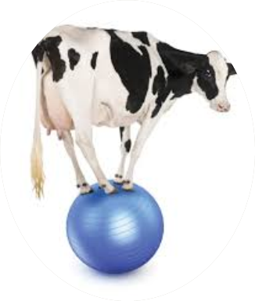
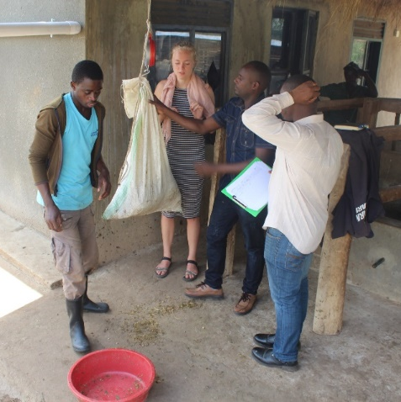
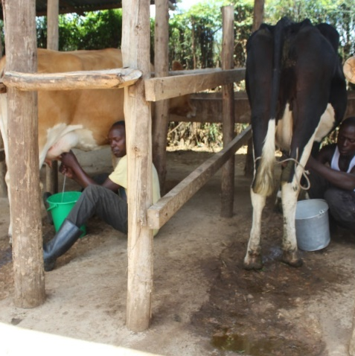

Livestock Sustainability Assessment Tool
(LSAT)
Why is Livestock Sustainability Assessment Important?
Asaah Ndambi
Wageningen Livestock Research, (WUR), November 15th, 2023
Notes:
We would have liked to start with professor Simon Oosting’s lecture, but he is not available until session 3, so we will start with the assignment that we will work on over the next three days.
As assignment, we would like you to assess the sustainability of a dairy production system you know well
For Indonesian pax, this is probably East Java,
For overseas pax, this may be a different system
We will use DSAT [spell out] as a tool.
You should have received 2 documents as background
DSAT description March 2022
DSAT Manual with explanation on Aspects and Indicators
If you have not done so yet, please read these documents today

Slide 2
Outline
Introduction
  Livestock sector contribution and challenges
  Global sustainability discussions
  Europe vs Africa perspectives
Why is it important to assess dairy sustainability?
  Policy makers
  Processors
  Input providers (feed, vet, equipment, credits)
What does the LSAT tool offer?

Slide 3



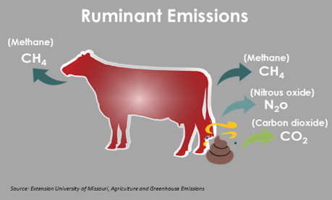
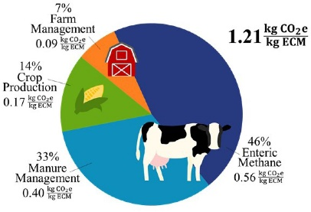
Introduction
Significance of the Livestock Industry
Key contributor to incomes and employment, food and nutrition security, impact on the GDP
Demand Side Factors
Anticipated production growth driven by global population growth and rising incomes leading to increasing demand
Challenges Related to Sustainability
Climate change poses a threat to the livestock industry
Increased incidence of drought impacts fodder and water supplies
Environmental Impact
Livestock contribute to 14.5% of global greenhouse gas emissions

Slide 4
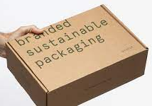
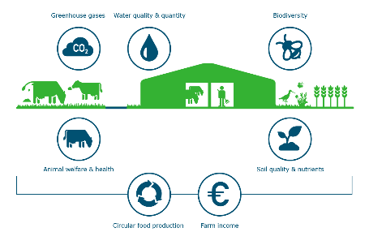
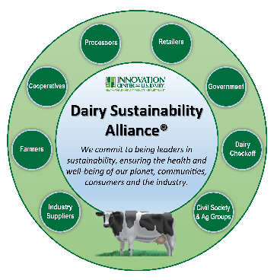
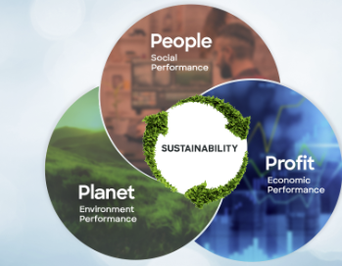

Sustainability talks are hitting the globe
Three Pillars of Sustainability: People, Planet, Profit:
  Integrate the People, Planet, Profit dimensions into the approach.
Resilience Through Sustainable Food Systems:
  Sustainable food systems play a role in mitigating volatilities. All actors along the chain are affected and can play a role.
Climate Commitments and Targets:
  Paris Agreement – 196 countries agreed to limit temperature rise to below 1.5ºc - NDCs
  The Conference of Parties (COP) meetings have been running since 1995 – COP 28 next week in Dubai
  Target to reduce greenhouse gas emissions by 43% by 2030 (UNFCC, 2022).

Slide 5
The sustainability perspective: Europe vs Africa
EU Trends:
Anticipated decline in milk production by 0.2% annually by 2032 due to herd reduction (EC, 2022) ➔ mounting concerns for animal welfare and the environment.
Economic Sustainability: Implementation of income support initiatives.
Environmental Sustainability: Enhanced conditionality and measures to promote soil health, biodiversity, and protect natural resources such as water.
Social Sustainability: Emphasis on animal welfare, nutrition, and health concerns.
Africa Trends
Emphasis on improving livestock productivity for income generation, food security, and combating childhood undernutrition and stunting (Balehegen, 2021).
Environmental sustainability is less prioritized due to pressure through population and economic growth (EC, 2022).
Challenges in Achieving Sustainability in Africa:
Inadequate adoption of sustainability-enhancing practices due to the limitations posed by smallholder farmers (Balehegen, 2021).
Preference for maintaining large herds of livestock for non-economic purposes (Forabosco et al., 2017).
Limited awareness & insufficient government support hinder adoption of sustainability practices.

Slide 6
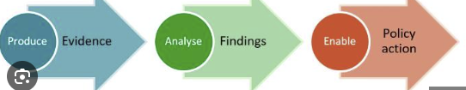
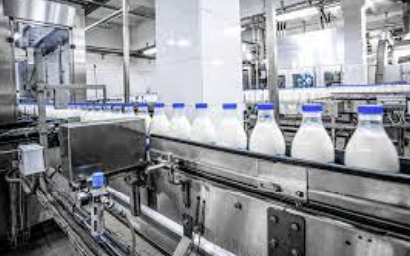

Why assess sustainability?
Guiding Policy Makers for Sustainable Development:
  Highlight the need for guidance on prioritizing key sustainability aspects for the formulation of supportive laws and bylaws.
Facilitating Input Providers for Sustainable Practices:
  Emphasize importance of developing feeds with high conversion efficiency, finance institutions to prioritize packages, other input providers being sensitive to sustainability.
Enhancing Processing for Stability and Sustainability:
  Processors can identify sustainability measures that improve efficiency along the chain and reduce production fluctuation.
Promoting Sustainable Choices to Consumers:
  Encourage processors to promote sustainable products over unsustainable ones to consumers.
Adapting Production for Changing Needs:
  Illustrate the need for adjustments in production methods, such as shifting towards organic agriculture, to meet evolving market demands (BAS–DEFOSSEZ, 2019).

Slide 7
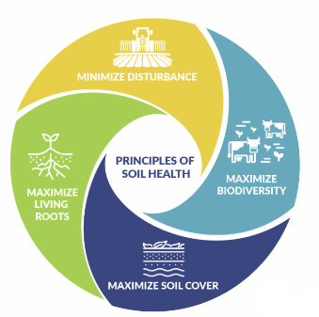
What the LSAT tool offers
Dairy Sustainability Assessment
  The dairy component of the LSAT: Dairy Sustainability Assessment Tool (DSAT), serves as a scorecard for assessing current sustainability issues and fostering stakeholder dialogue.
Application and Testing of the Tool
  The DSAT has been successfully tested and applied in workshops and training sessions in Ethiopia, Kenya, Rwanda, Tanzania and Uganda.
Comprehensive Approach
  The tool encompasses the three pillars of sustainability: Economic, social, and environmental aspects.
Customizable Assessment for Acute Threats
  Users can select specific aspects they deem critical to the sustainability of their dairy venture.

Slide 8
What inspired DSAT development
Use DSAT as a tool to facilitate constructive discussion on the people-planet-profit sustainability of dairy production, helping stakeholders to:
  Identify the main threats to sustainability
  Score the current performance of the dairy system(s)
  Generate further discussions on pathways and actions on how dairy can generate healthy diets, income & livelihoods, and a sustainable resource base
➔ DSAT was developed for East Africa
Notes:
Dairy stakeholders benefit, ecological resource base is maintained, sufficient value is added to the economy – not just for us and now, but for our children and grandchildren

Slide 9

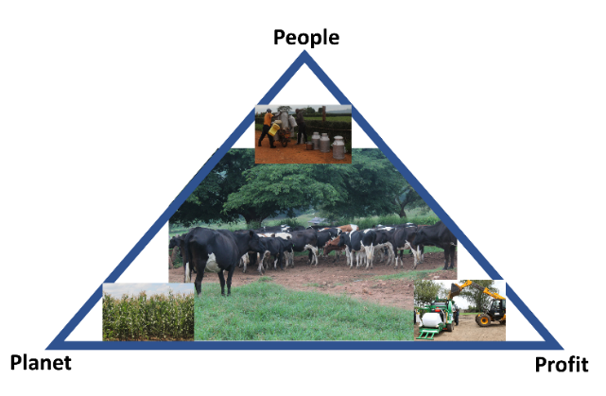
How DSAT was developed – 10 steps
Inspiration
Overview of potential threats to dairy sustainability
Selected key sustainability aspects, with people, profit and planet angles
Defined 3 relevant system scales: farm, region/milkshed/cluster and sector/national level
Selected indicators for sustainability aspects, across system scales, based on previous studies: RISE, SAFA, PG, IDEA and TAPE tools (Ndambi et al., 2020; Mottet et al., 2020).

Slide 10
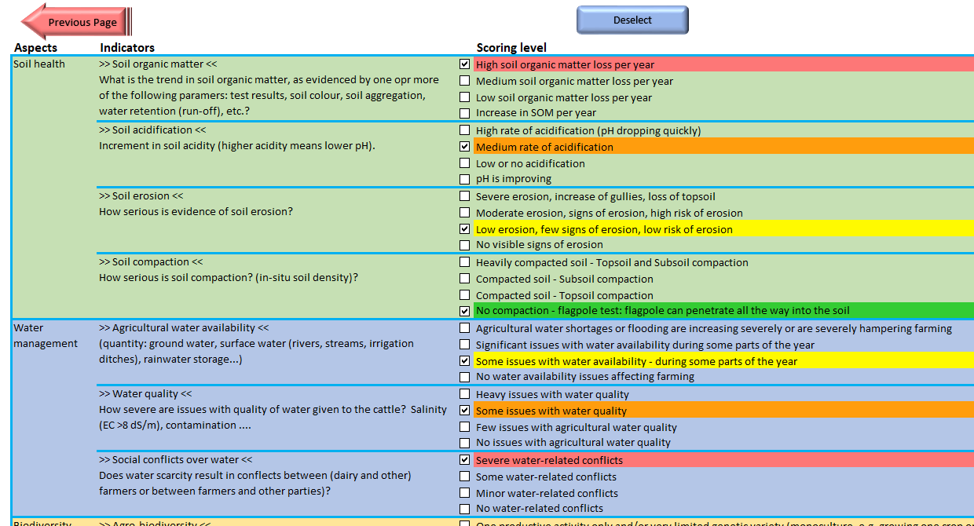
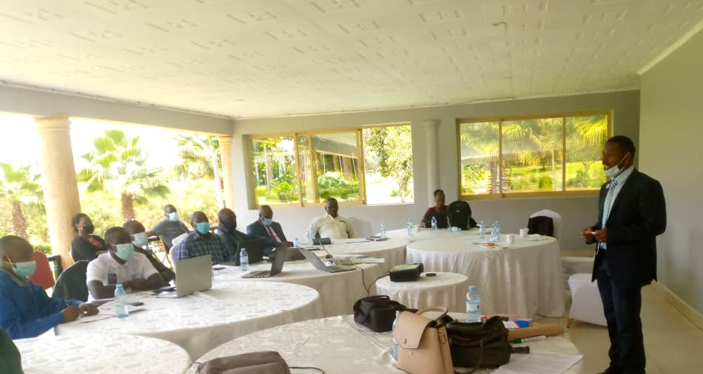
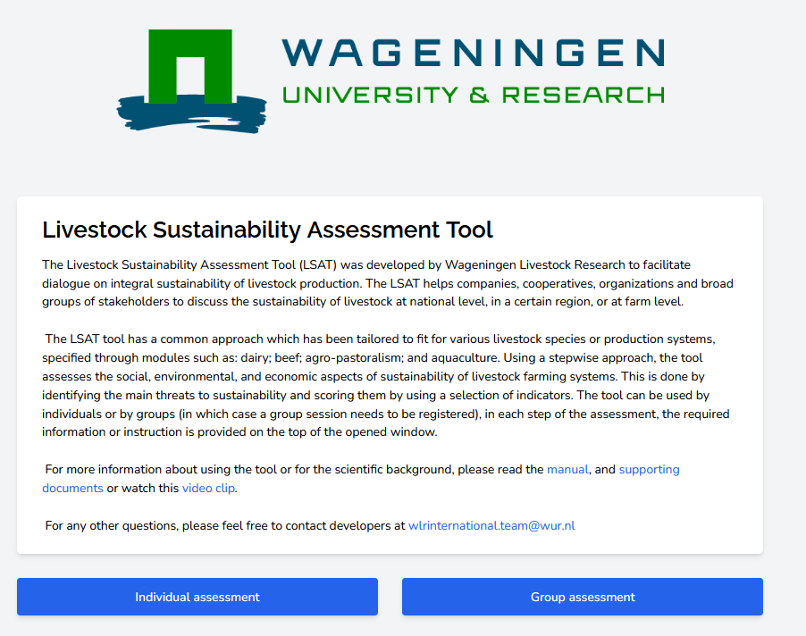
How DSAT was developed – 10 steps cont.
f. Developed four score levels per indicator
g. Multiple rounds input steering committee
h. Finalized the draft tool and piloted in Uganda and Ethiopia (Oct-Dec 2021)
i. Tool revision, drafting of manual and facilitation guide, publication of description (Jan-March 2022)
j. Further validation and development, including web-based version

Slide 11
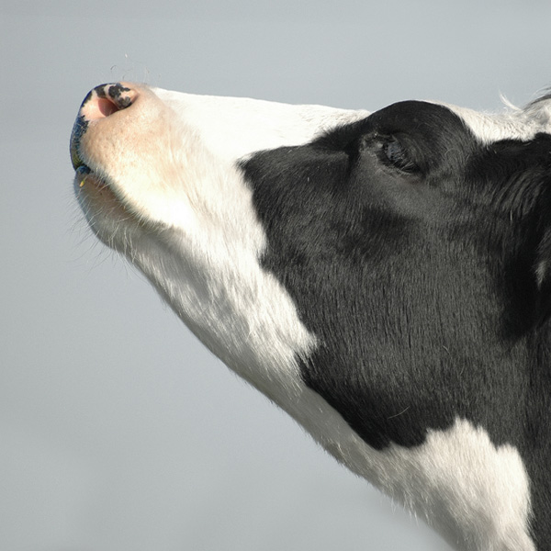
Thank you very much for your attention !!!
We have made great progress…
… and still realize it is an ongoing process!
Contact Email WhatsApp/Telegram
Asaah Ndambi asaah.ndambi@wur.nl +254 700 706 398

