Slide 1
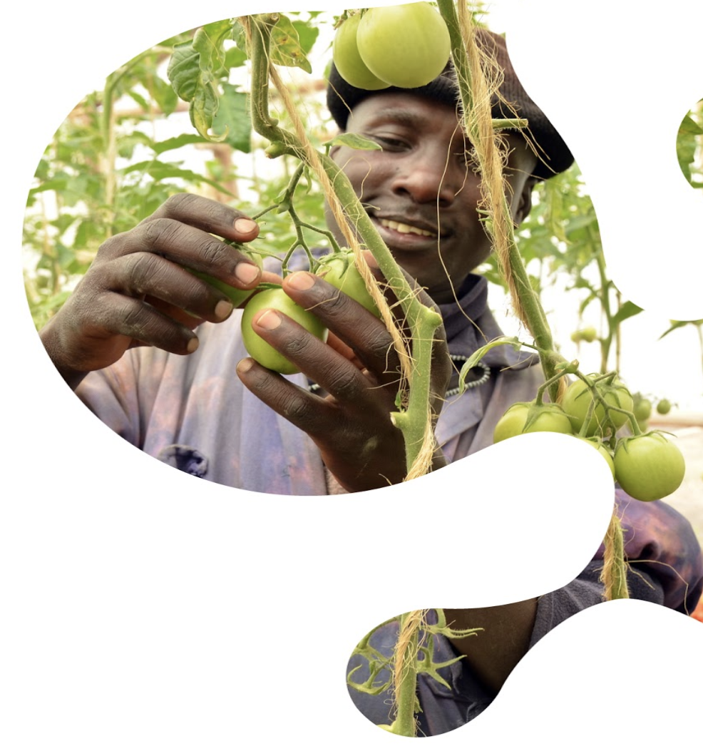
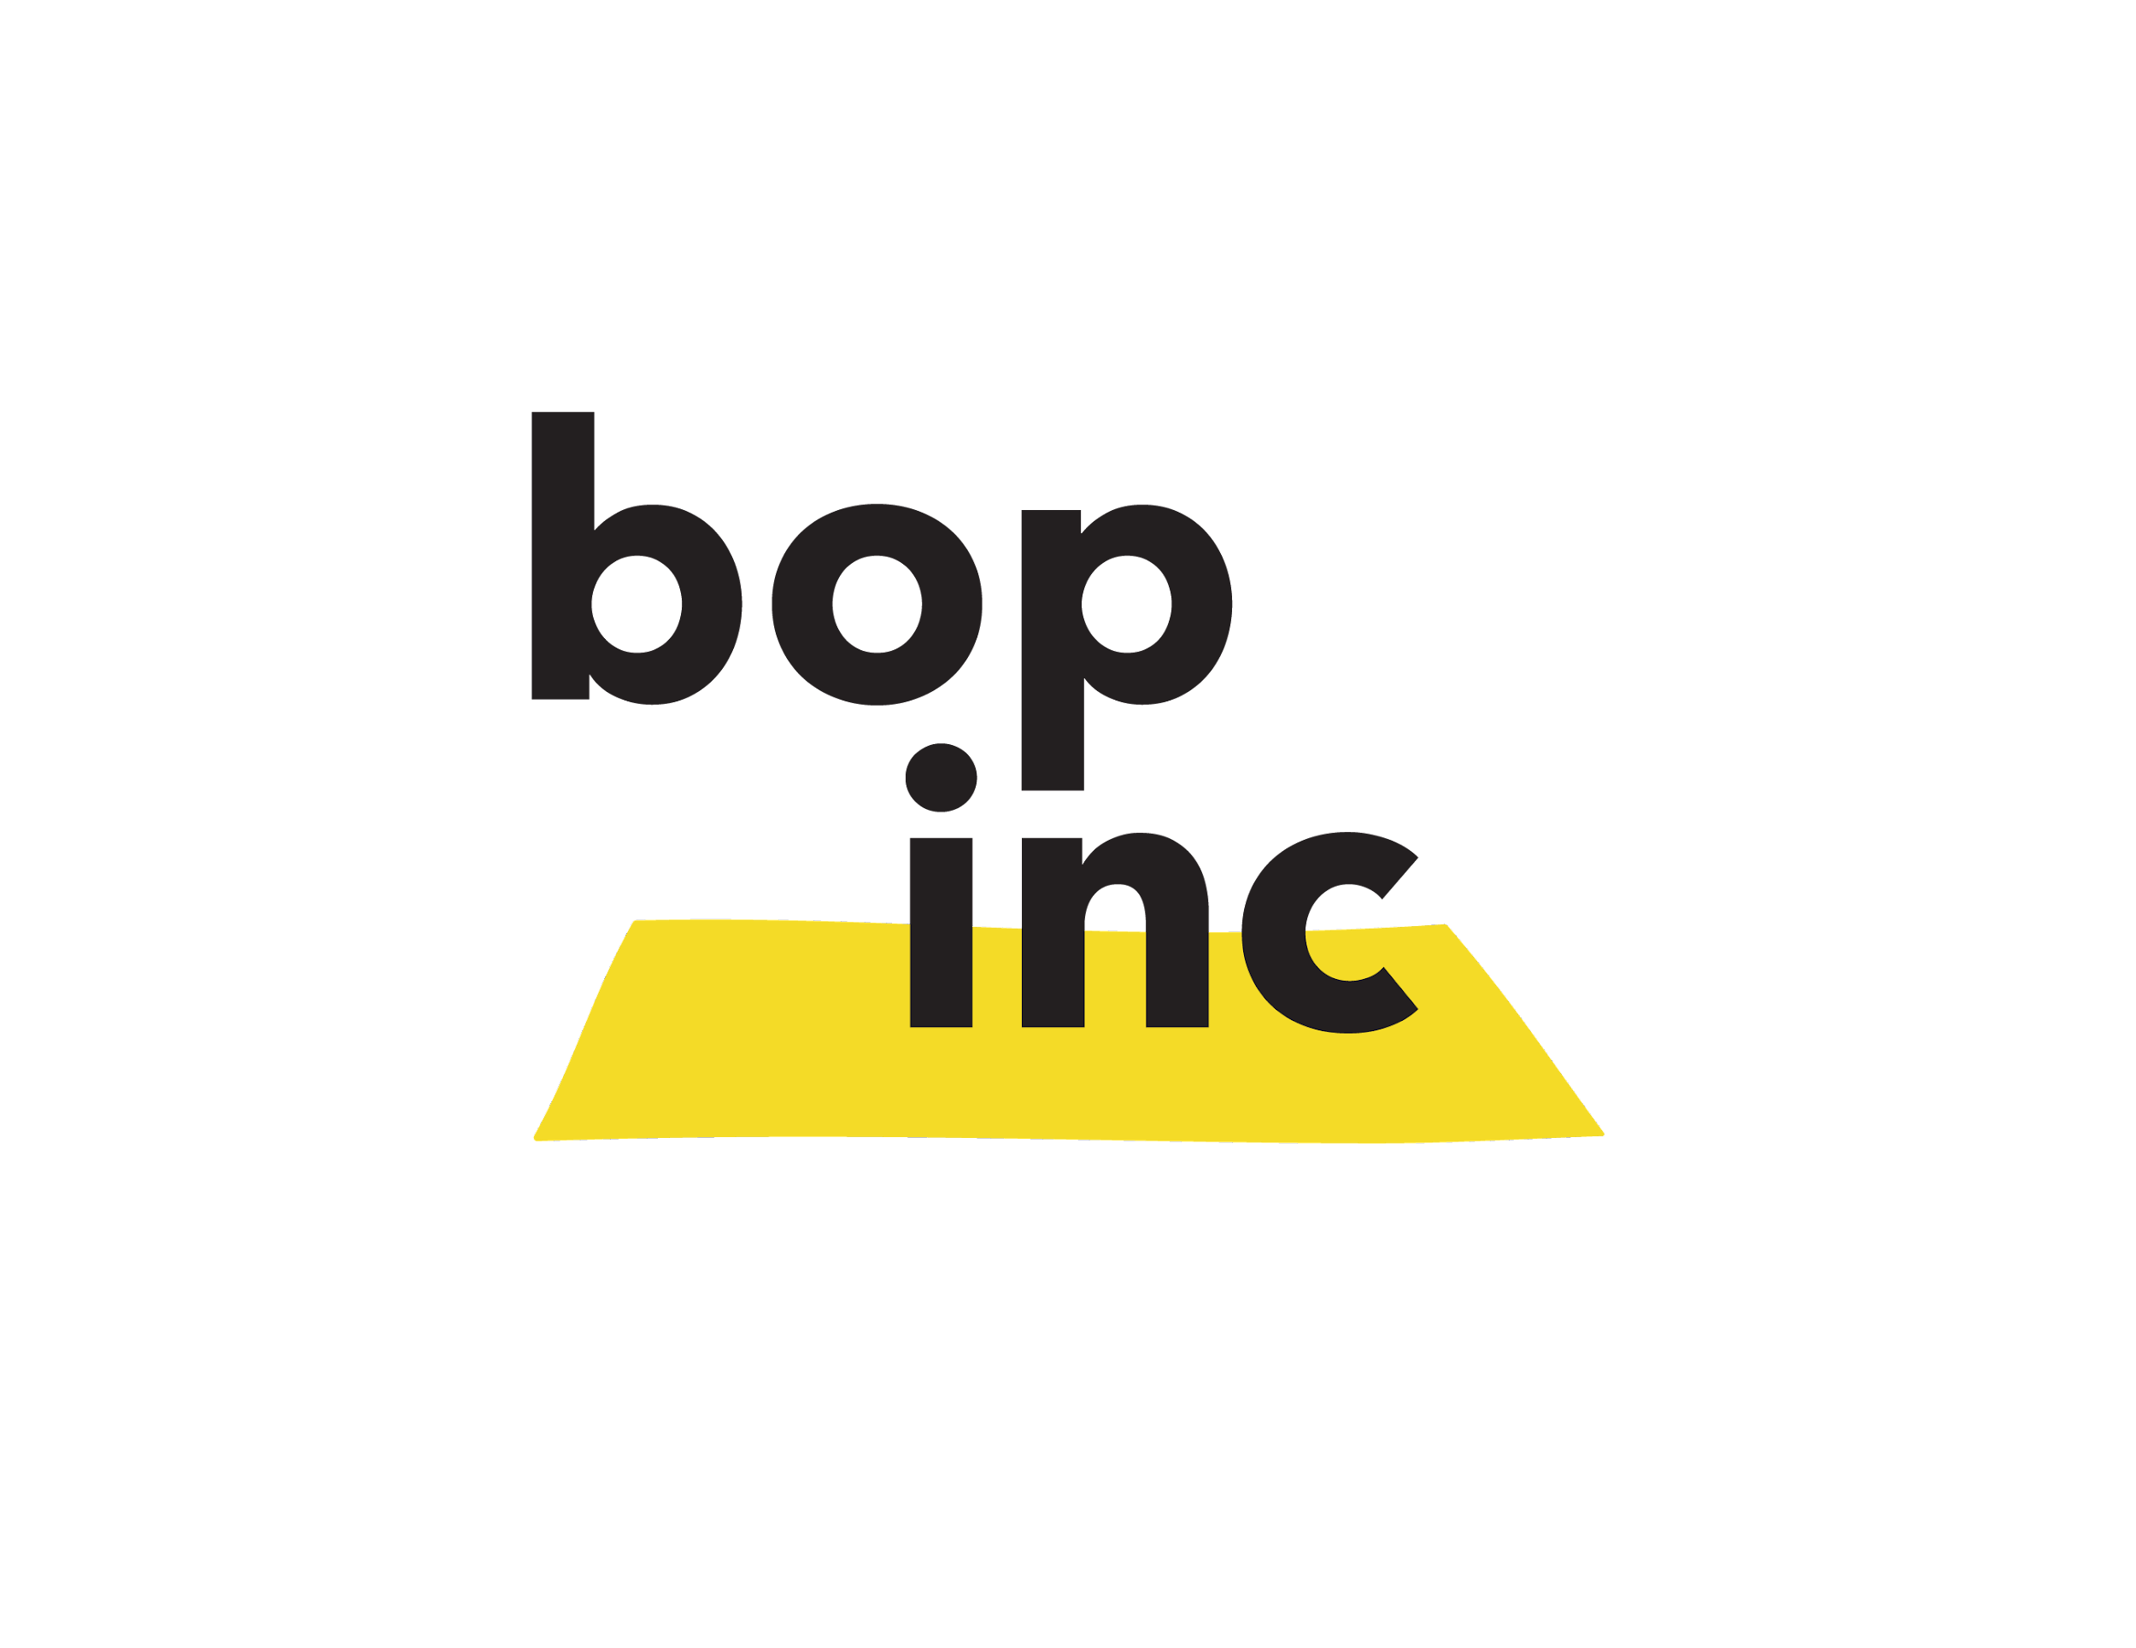
Digital agrifood Collective
Commercial viability assessment tool
Use this tool to assess the commercial viability of the digital service providers you work with.

Slide 2
Commercial viability assessment tool
Example of a fictional company
1. Your team
Does your team have entrepreneurs with the intention and capabilities to sell on a commercial basis?
Through their sales team, the company establishes commercial relationships with farmer touch points such as agribusinesses, insurance and input providers.
4. Your revenue model
How do your customers pay you? For your paying customers (in 3b), choose a revenue model and add the price point.
5. Your profit & loss
What are your annual costs?
How much of these costs are covered with revenues you generate?
Farmers: Airtime
Agribusiness: Contracts with farmers paying through input purchase
Cash out:
Cash in:
Staff: 30k Office: 7k
Marketing: 9k
Data: 14k
= $ 60k /year
B2C revenues: 15k
B2B revenues: 15k
Grants: 15k
= $ 45k /year
2. Your offering
Do you have something “sellable”?
And have you validated your target group is happy with your offering?
Weather forecasting and crop advisory SMS service for smallholder farmers. Farmers are willing to pay if the service is bundled, for instance with inputs.
Difference: $ -15k /year
3a. Your end user
Who uses your offering primarily?
3b. Your paying customer
Who is willing to pay your bills and what do you offer them in return?
% of income coming from revenues:
67%
Farmers and other individuals
SHFs, extension workers
Large value chain actors
Agribusinesses
Other
Farmers (B2C)
SHFs, extension workers
Large value chain actors (B2B)
Agribusinesses, input retailers
Financial institutions
Other (B2G, B2NGO)
(Development grants)
6. Your potential to scale
What can you do to maximise your revenues and reduce your costs? With these strategies, what is the realistic market size that you can obtain?
Costs reductions:
New revenues:
33%
Reduce farmer marketing costs by leveraging loyal farmers.
Drive loyalty and monthly payments from farmers.
33%
33%
3m SHFs
Obtainable market size:
Notes:
Ask these questions:
Who pays?
What do they pay for?
When and how do they pay?
Is this enough to financially sustain my business (also look at steady cash flow)

Slide 3
Commercial viability assessment tool
Blank Worksheet
1. Your team
Does your team have entrepreneurs with the intention and capabilities to sell on a commercial basis?
…
4. Your revenue model
How do your customers pay you? For your paying customers (in 3b), choose a revenue model and add the price point.
5. Your profit & loss
What are your annual costs?
How much of these costs are covered with revenues you generate?
Yes
Examples:
For B2C, subscriptions at $2 per season
For B2B, advertising at $100 for 1,000 SMS
More examples in the Annex
Cash out:
Examples: Staff, geodata, marketing, etc,
Cash in:
Examples: Revenues, loan, donations, etc.
2. Your offering
Do you have something “sellable”?
And have you validated your target group is happy with your offering?
…
Yes
Difference:
3a. Your end user
Who uses your offering primarily?
3b. Your paying customer
Who is willing to pay your bills and what do you offer them in return?
% of income coming from revenues:
Farmers and other individuals
Large value chain actors
Other
Farmers (B2C)
Large value chain actors (B2B)
Other (B2G, B2NGO)
6. Your potential to scale
What can you do to maximise your revenues and reduce your costs? With these strategies, what is the realistic market size that you can obtain?
Costs reductions:
Examples: Use of open data or partner with NGOs.
New revenues:
Examples: Advertising or add new service offering
Obtainable market size:
Notes:
Ask these questions:
Who pays?
What do they pay for?
When and how do they pay?
Is this enough to financially sustain my business (also look at steady cash flow)

Slide 4
Commercial viability assessment tool
Annex: revenue models
Revenue model | Explanation | Example | Advantages
Pay-per-use (B2C) | Customers pay on the basis of what they effectively use. | Farmer advisory SMS. Mobile money transactions. | Lowers the perceived entry barrier for customer to try out new solutions for as much/long as they want.
Subscriptions (B2C, B2B) | Customers pay a regular fee, usually on a monthly or annual basis, to gain access to a product or service. | SaaS providers for eg. ERP software. Weather forecast subscriptions. | While customers benefit from lower usage costs (in the long run) and guaranteed service availability, the company generates a predictable and steady income stream.
Freemium model (B2C) | Customers enjoy a basic version of of the offering for free. Once persuaded by the benefits, customers to pay for the premium version. | Social media like Linkedin. | A free offering attracts large volume of customers that want to “try-before-they-buy”. Although a smaller subset, premium customers can generate sufficient revenue.
Data monetisation (B2B) | Stakeholders such as governments, large companies and financial institutions pay for the aggregated data collected about the users of the service. | Food production forecasts. Farmer credit worthiness. Targeted marketing. | Can be a lucrative additional revenue stream when large volumes of data are collected anyhow. Data analytics and AI can generate unique insights that can be extremely valuable for large agrifood value chain actors.
Indirect payments (B2B) | Customers pay indirectly through other transactions such as: data they provide, a deduction from their income, their payments for loans/insurance/mobile money. | Input sales bundled with SMS advisory. | Provides opportunities to collaborate with other actors in the value chain.
Advertising (B2B) | End-users do not pay as the main source of revenue comes from a third party customer that is interested in advertising to your customers/user base. | Social media like Facebook. Input adverts in farmer advisory SMS messaging. | Lowers the barrier for users/customers to engage, while the service provider benefits from large brands paying for advertisements. Finding a few paying advertisers can be easier than finding a lot of paying farmers.
Licensing (B2B) | The licensor (firm that develops/sells the technology/service) transfers know-how and assets to the licensee (firm wanting to the the same technology/service) that pays a license fee. | New seed varieties. | Creates opportunities for faster and more widespread introduction of a service, particularly when licensing to customers with large networks of farmers/customers.
Notes:
ROJAN suggests: Add case study. We tested this before.

Slide 5
Commercial viability assessment tool
Annex: cost reduction strategies
Cost minimisation strategies for digital service providers | Explanation
Collaboration | Collaborating with other parties to share costs of eg. marketing and farmer training. These can be NGOs or GOs that share similar goals of empowering smallholders.
Smaller teams | Optimizing the number of FTEs in the core team and/or working with team members or freelancers (such as developers) in countries where salaries are lower.
Open data | Using open datasets (eg. Sentinel satellite data) instead of paying for data.
Low-cost procurement | Replacing existing service providers by more affordable ones.
Economies of scale | Scaling the service to more farmers or other users, either individually or through licensing of the service to organisation in countries where the service provider is not active yet.
Notes:
ROJAN suggests: Add case study. We tested this before.

